Slide 1
Homework 04 - Canny Edge Detection
Dhiren Gupta
-800902466

Slide 2
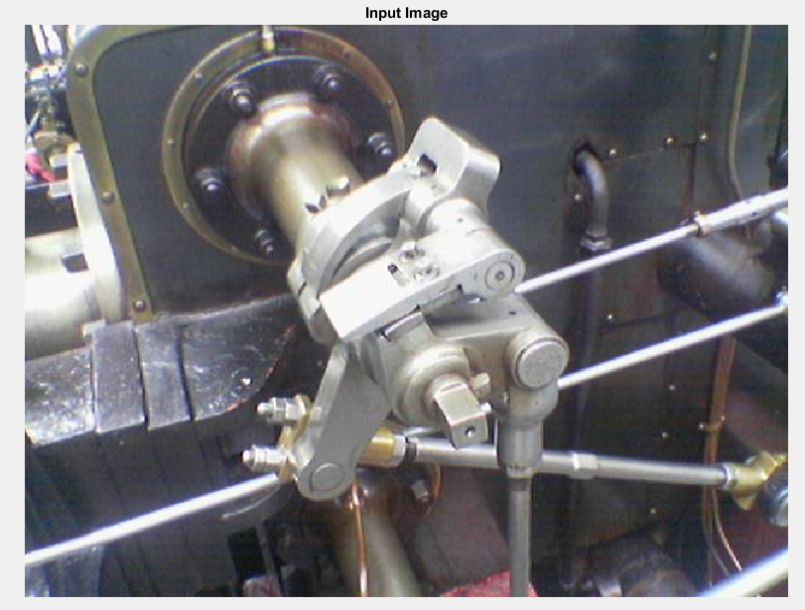
Input Image

Slide 3
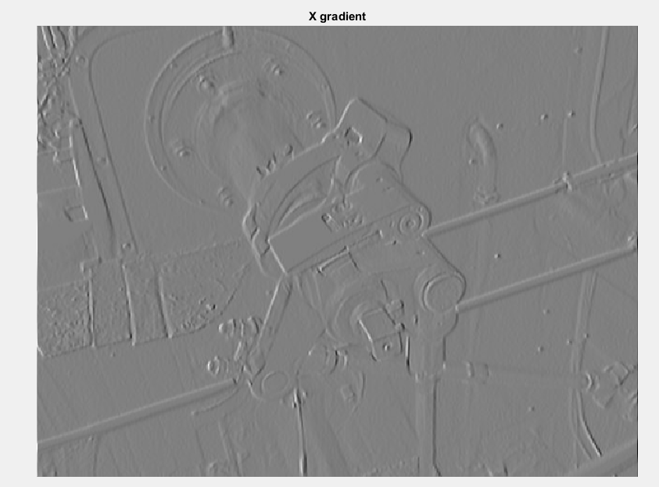
Gradient x

Slide 4
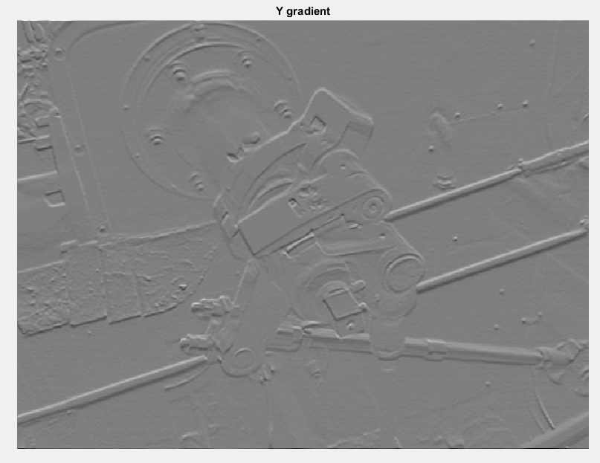
Gradient y

Slide 5
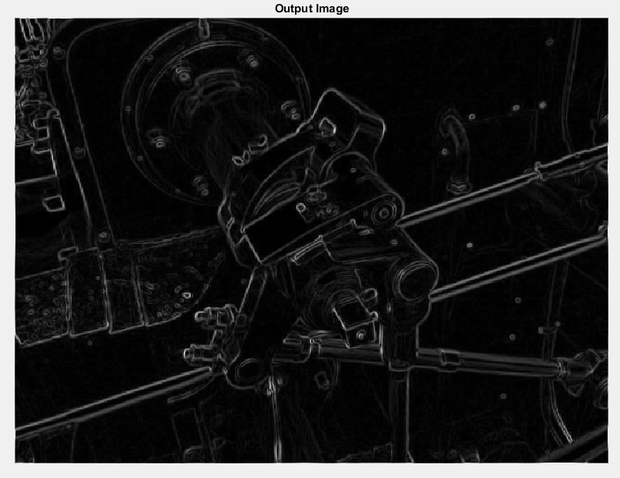
Gradient Magnitude

Slide 6
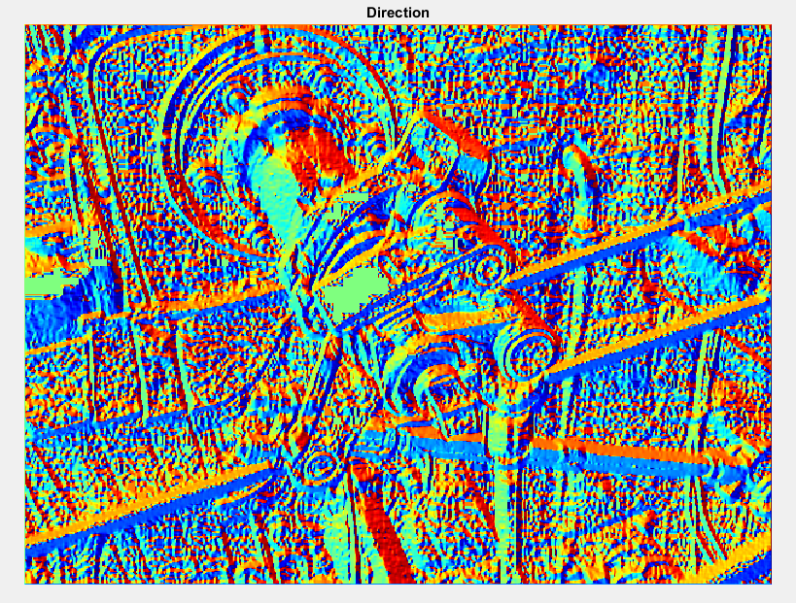
Gradient Direction

Slide 7
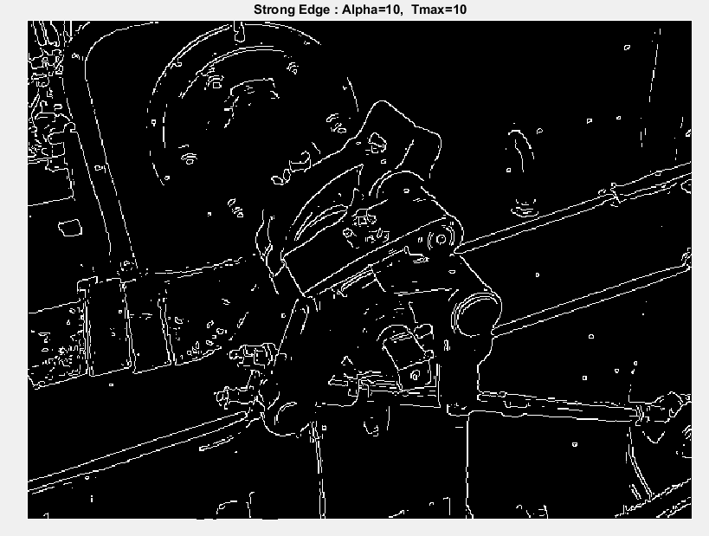
Strong Edge

Slide 8
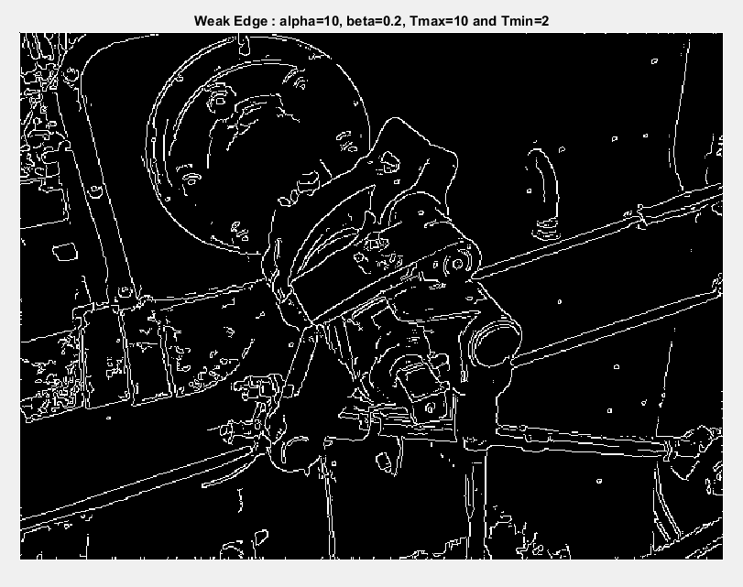
Weak Edge

Slide 9
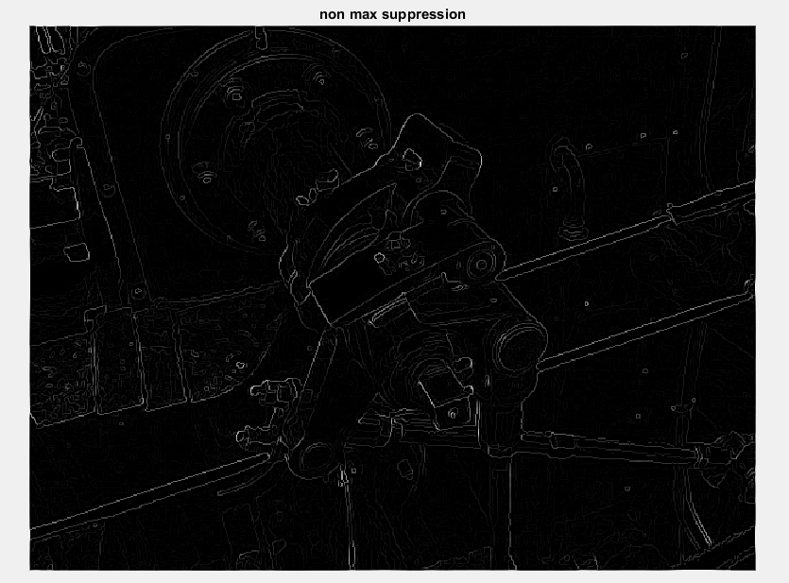
Comparison
Non Max suppression image has thinner edge.

Slide 10
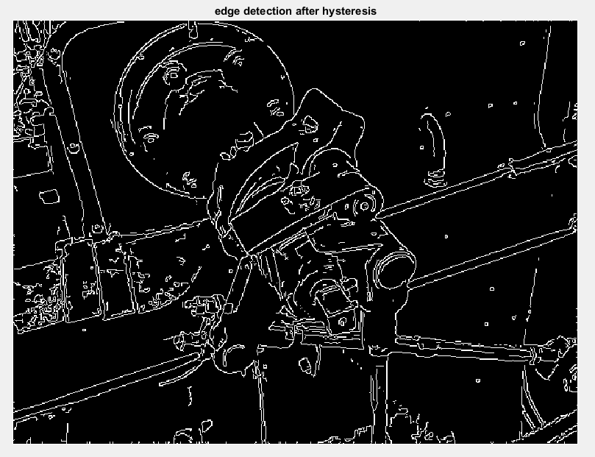
Comparison
Edge Detection After hysteresis
Strong Edge

Slide 11
Comparison
Edge Detection After hysteresis
Weak Edge

Slide 12
Thank You

